Slide 1
Homework 3
Broken electric appliance transport service

Slide 2
Team introduction
We are team 11.
Our members: 106034071 廖允寬
106034076 麥祐嘉
106034077 張祐綱

Slide 3
Idea
Many stores don’t offer doorstep service so you need to bring the broken product to the store by yourself.
we use the postal transport service to go to the clients’ home to receive their broken product, and then send the product to the nearest repair shop.
When the product is repaired, we send it back.

Slide 4
Input
Process
Output
A Broken product
Repair sheet
Send product to the repair shop
Repair the product
Send the product back and charge for shipping
A repaired product

Slide 5
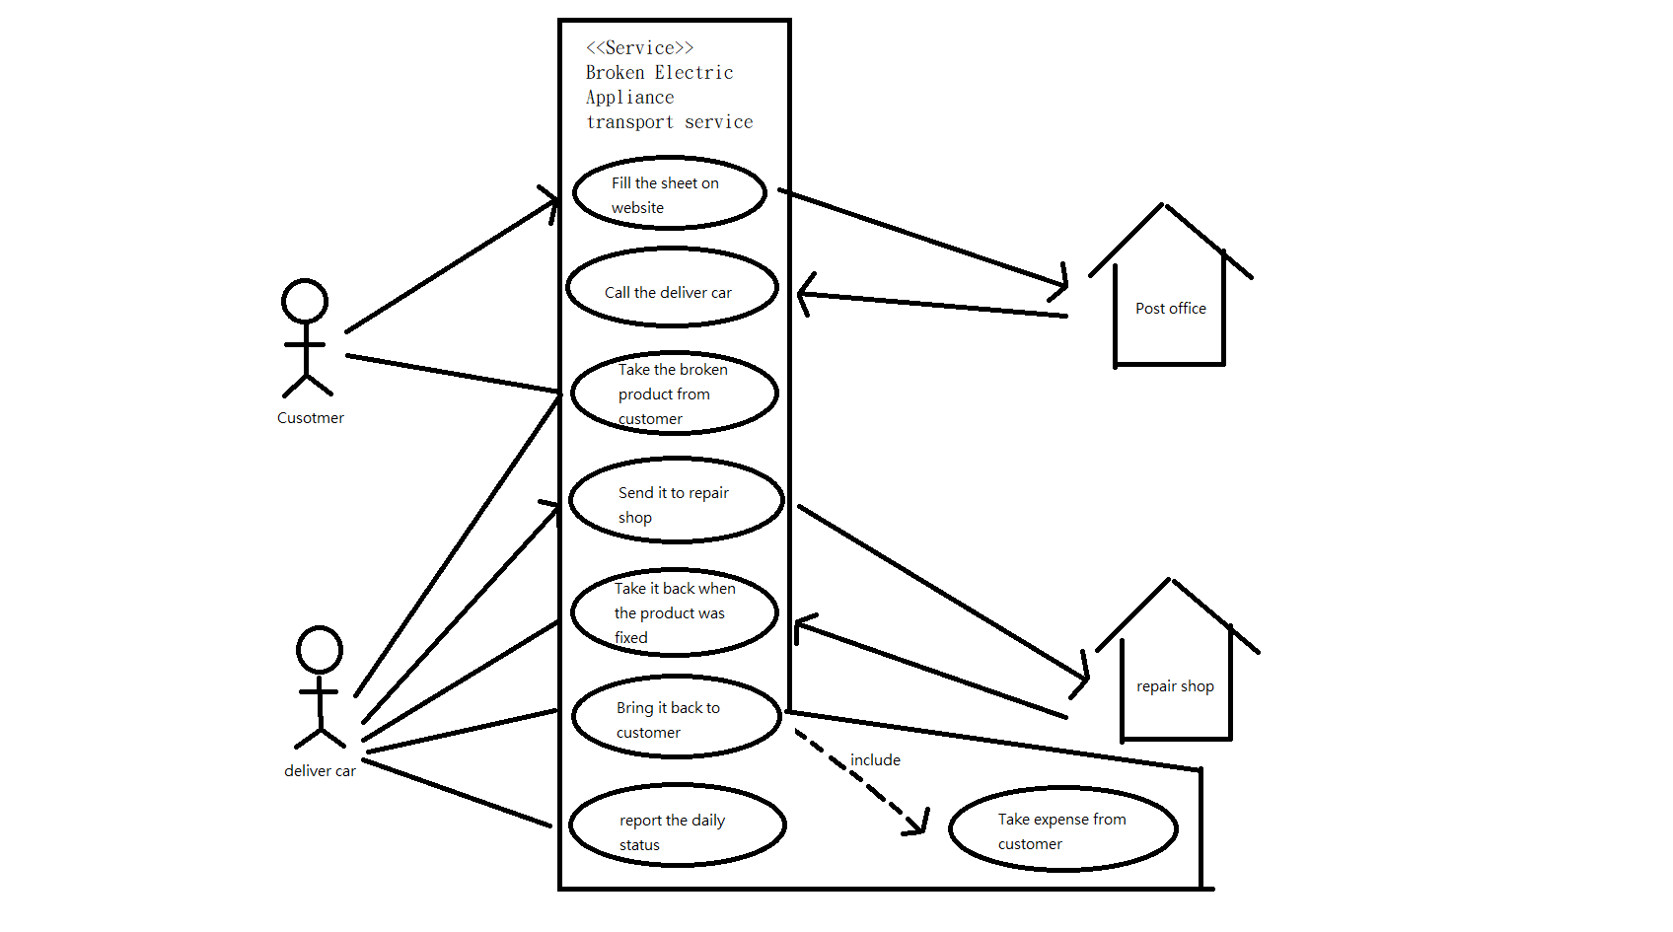
Use case diagram 1

Slide 6
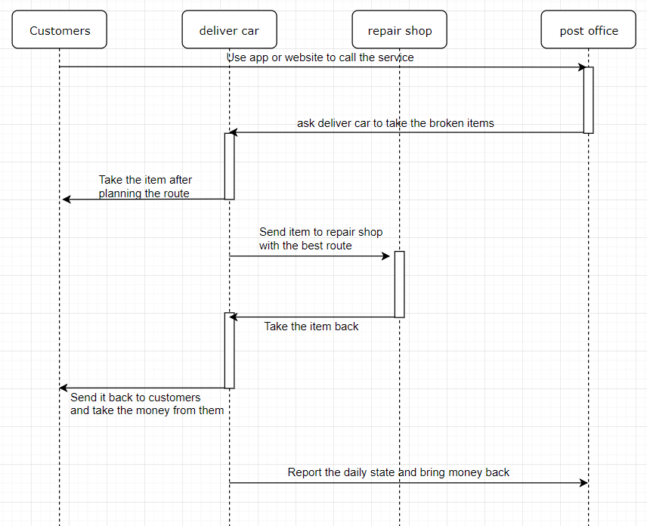
Sequence diagram 1

Slide 7
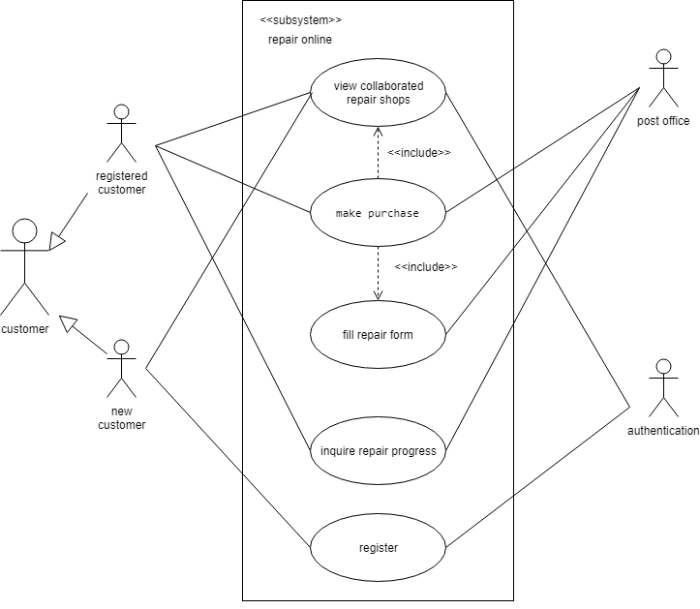
Use case diagram 2

Slide 8
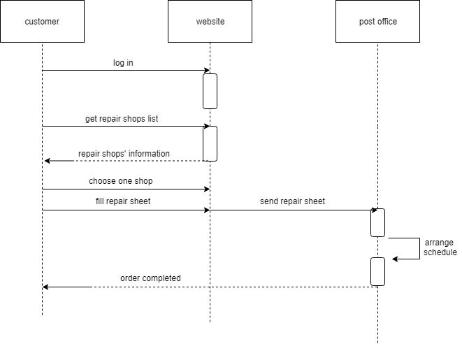
Sequence diagram 2

Slide 9
Q&A

